Slide 1
DarkQuest Update (1)
Duc Hoang

Slide 2
Hit sharing investigation

Slide 3
Overview
1D distribution of fraction of shared hits between DC off and DC on
Tracklet pz - truth pz w.r.t to hit shared fraction

Slide 4
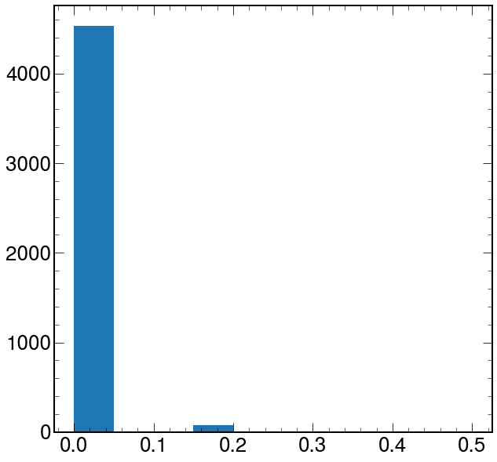
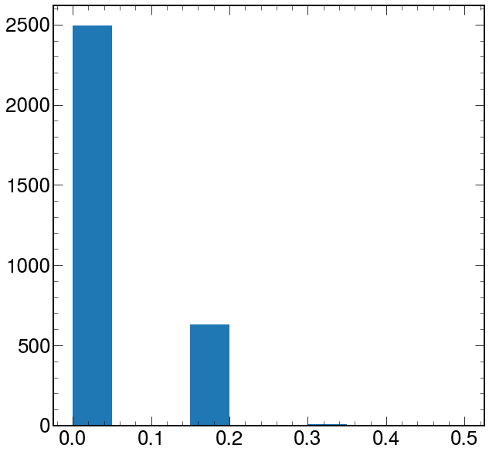
1D distribution of shared hits
DC off
DC on
Nothing super conclusive about these plots. We know vertexing with DC emulation has worse resolution so this might be an early indication of that. But this might also be a feature that improve the resolution when DC emulation is turned on.

Slide 5
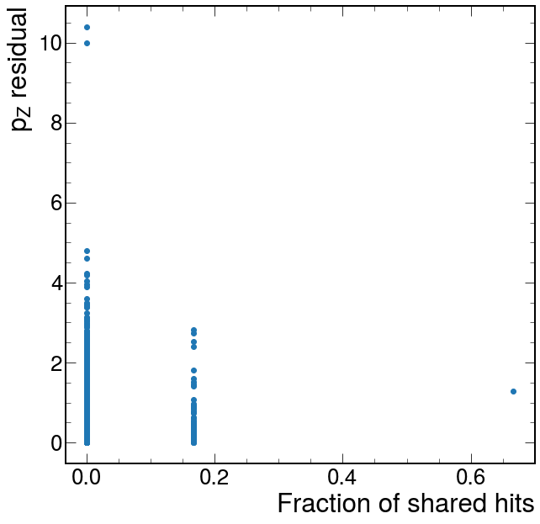
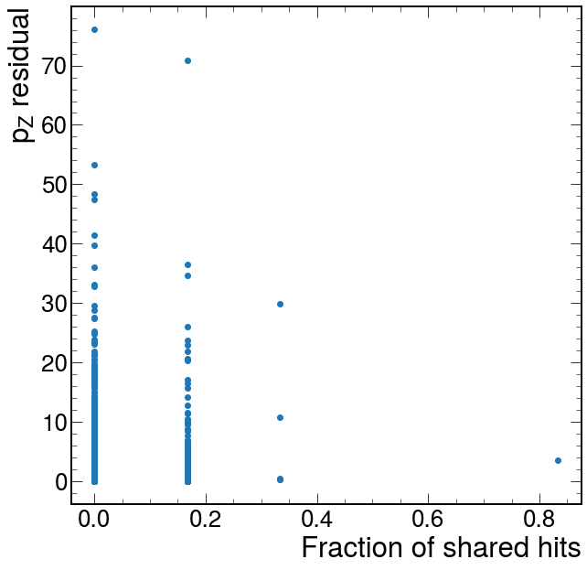
Tracklet residual w.r.t fraction of hits shared
DC off
DC on
Looking at this I’m not sure if hit sharing is the cause of degrading pz resolution.

Slide 6
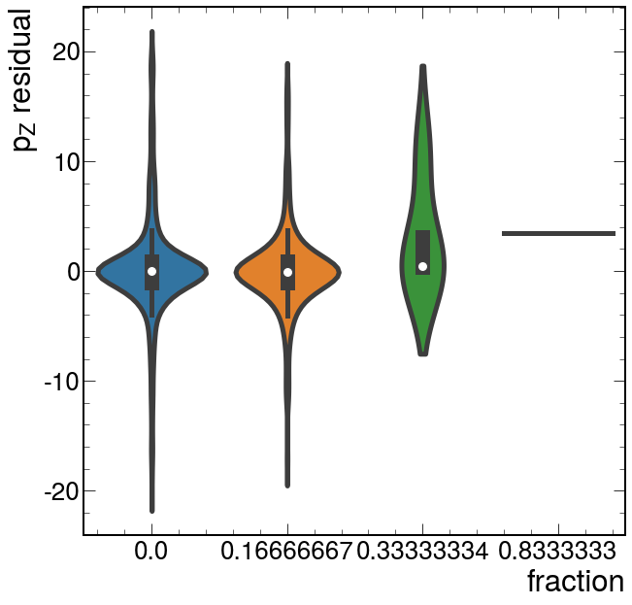
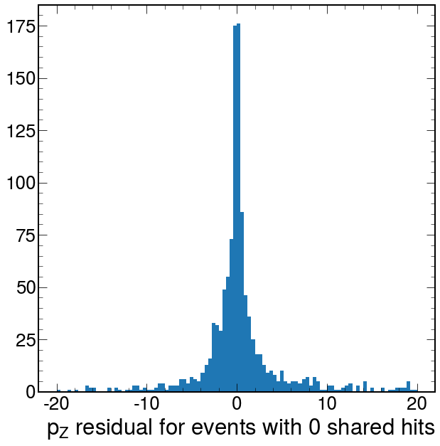
Residual distributions
0 shared hits
It seems that the more hits you shared, the more skewed the distribution.
Notes:
Tracks will be rejected if have too few hits
Track has to have at least 1 hit on one of the pairs wires and 4 hits overall.

Slide 7
TRacket reco study

Slide 8
Things to check
Check tracklet pz and SQRecTrack pz to truth pz.
From Patrick: “It might be that SQRecTrack has some baked in assumptions about the particle coming from the origin.”
Tracklet pz not available in ntuples.
Not too hard to get
SQRecTrack is in here.
Compare tracklet pz to SQRecTrack pz.
Tracklet pz to truth pz
Based on monday’s discussion:
Suspect that pz measurements skew come from hit sharing in station 1.

Slide 9
Sample overview
10k A’ to muons events with medium mass (1.55 GeV) decaying in between 5-6m.

Slide 10
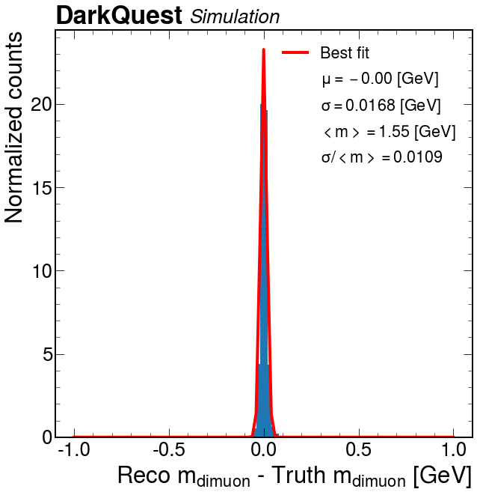
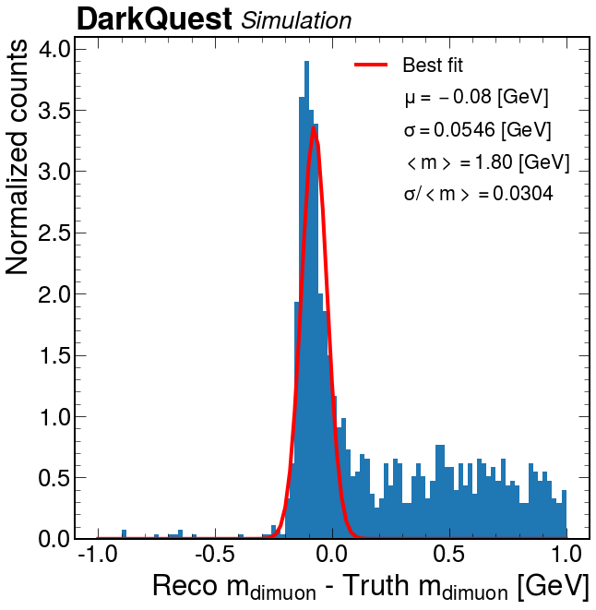
Mass resolution
DC off
DC on

Slide 11
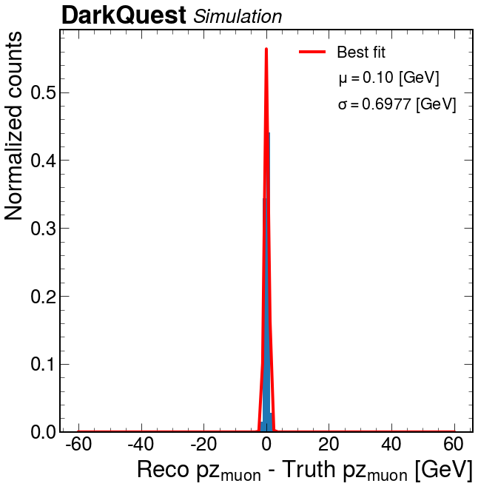
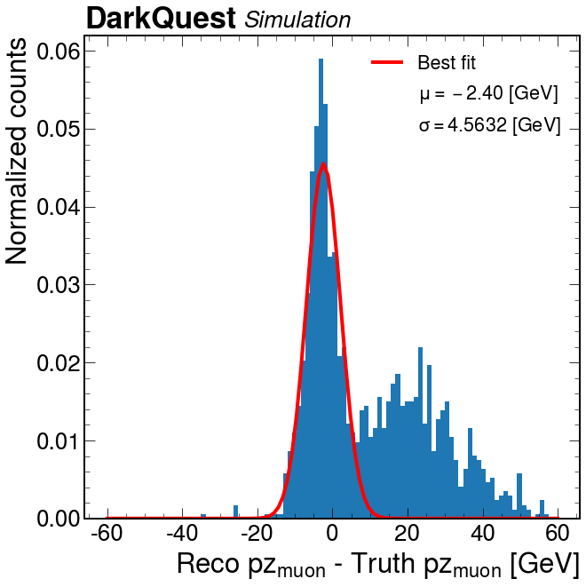
Tracklet pz to truth pz (sum pz of 2 tracklets and the truth pz)
DC off
DC on

Slide 12
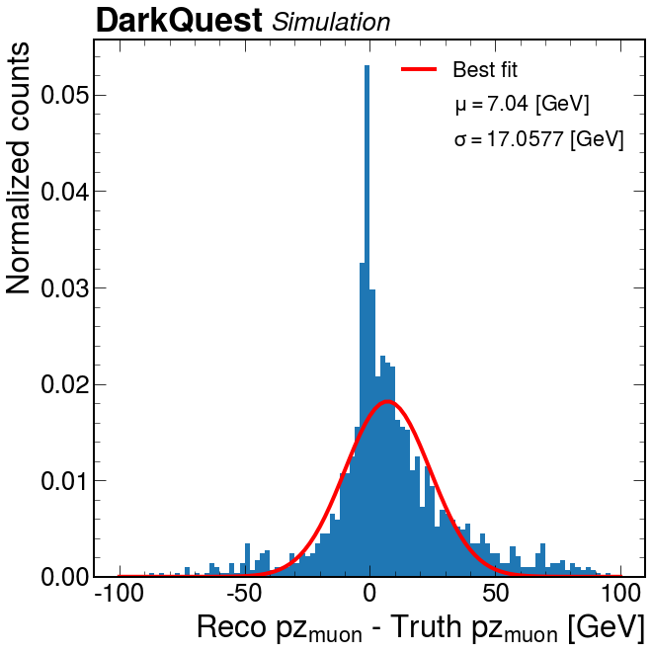
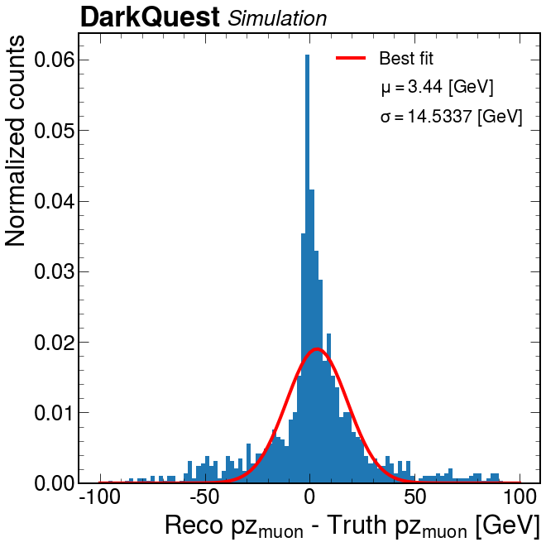
Tracklet pz to truth pz (2 tracklets and individual tracks)
P_pz versus first tracklet
N_pz versus second tracklet
Note that there is no truth matching so there might be imperfect matches between individual truth pz and the tracklet

Slide 13
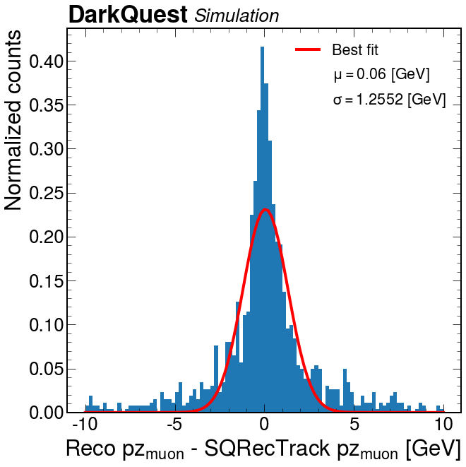
Tracklet pz to SQRecTrack pz (sum of 2 tracklets and reco’ed pz )

Slide 14
Conclusion
The weird tail already appears from the tracklet level.
What are the possible causes?
Hit sharing in station 1 tracklets

Slide 15
Improving VERTEXING: UNderstand where the weird tails come from

Slide 16
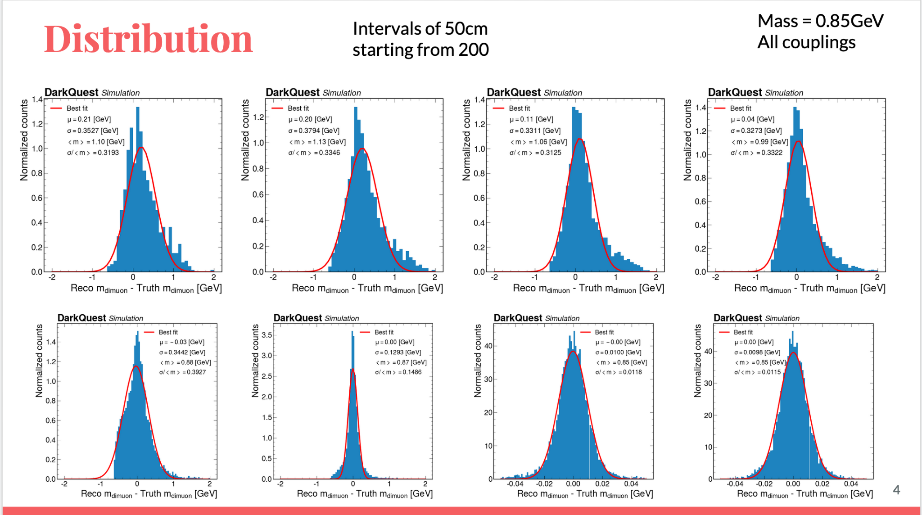
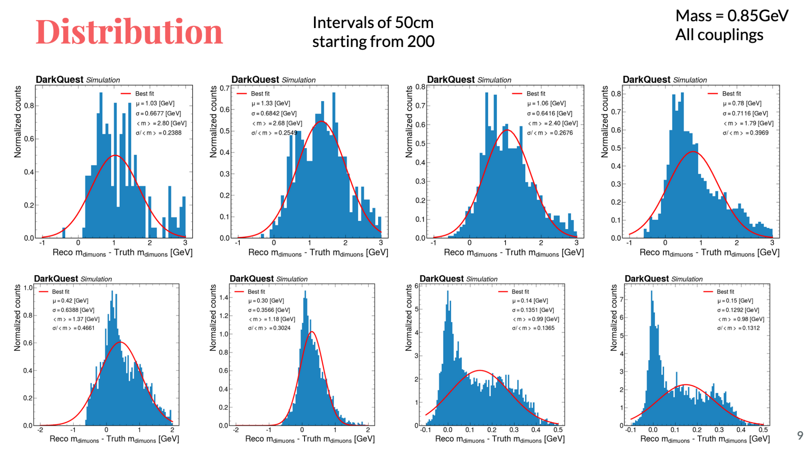
Main objective: understand why
DC emulation on:

Slide 17
Taking the first look
Generate A’ sample w.o DC emulation
Save DST file
Use same DST file when DC is on

Slide 18
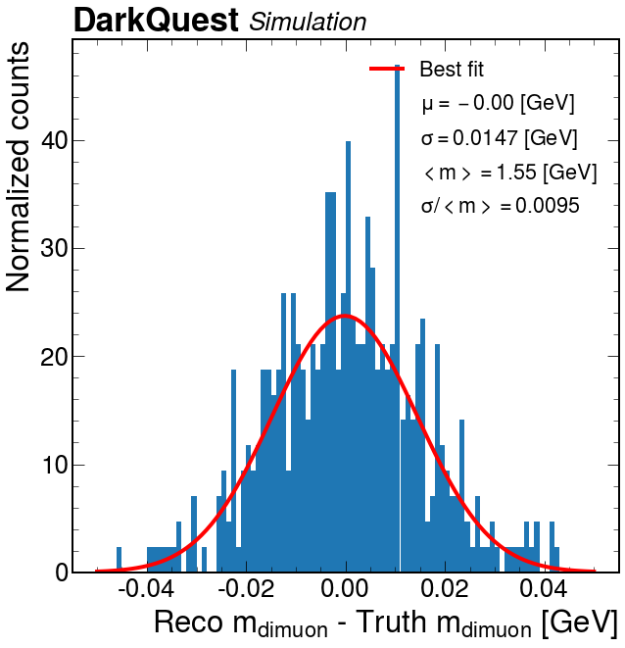
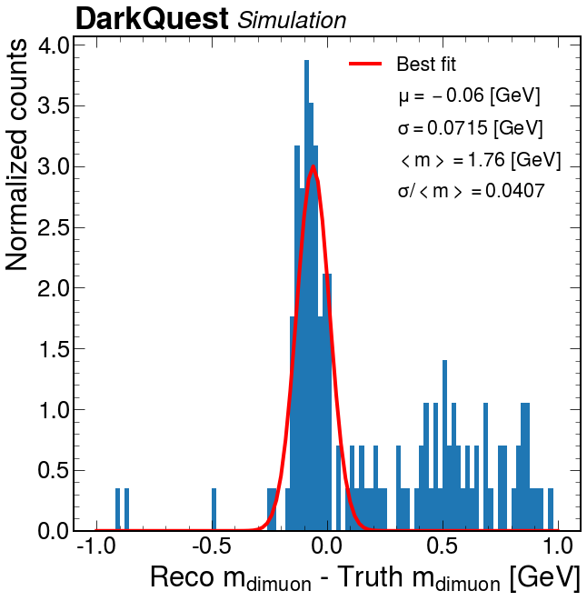
Rechecking the distribution
Turning on DC Emulation
Weird tail still exists

Slide 19
With and w.o DC emulation
Prompt (Drell-Yan)✅
Light A’ ✅
Heavy A’ ✅
Medium A’ ✅
Might want to add pre_refit track paras into ntuples: position & momentum. ✅

Slide 20
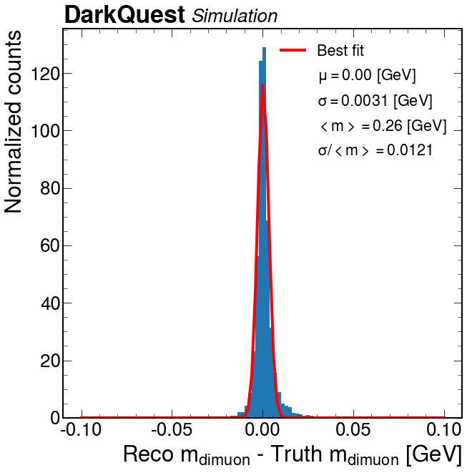
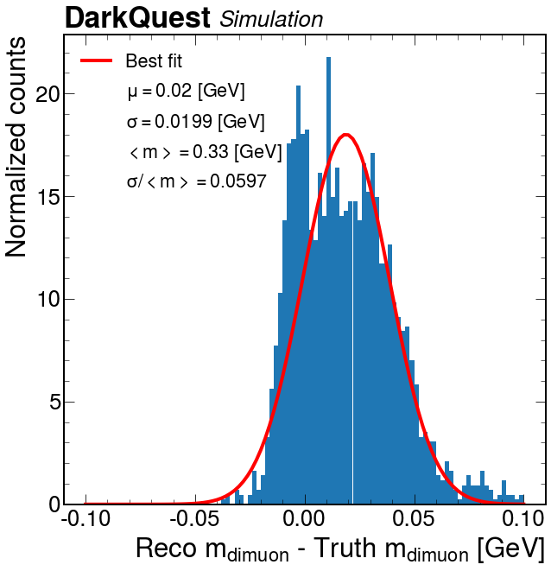
Light A’
DC off
DC on

Slide 21
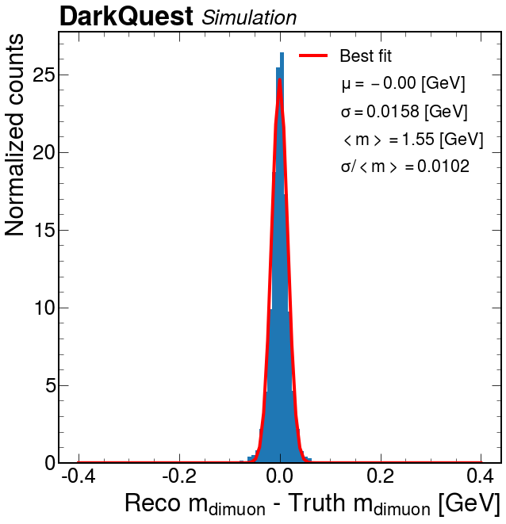
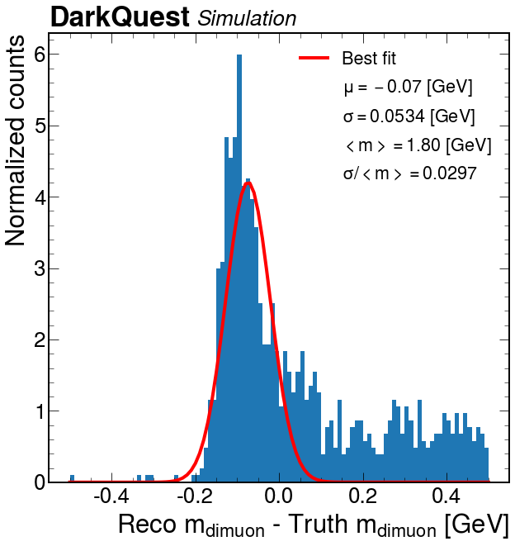
Medium A’
DC off
DC on

Slide 22
Medium A’ – peak and tail

Slide 23
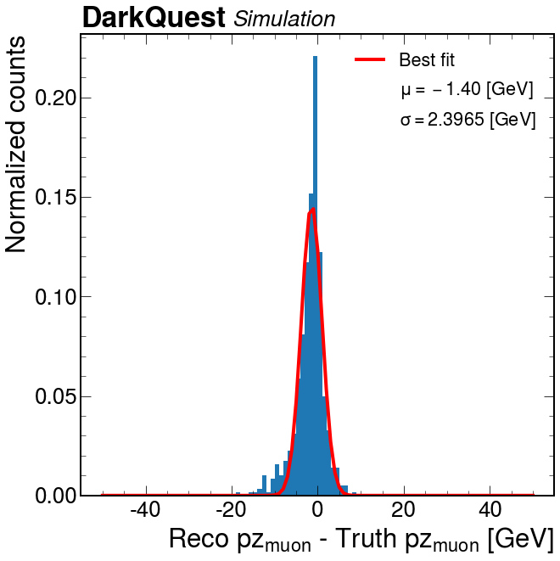
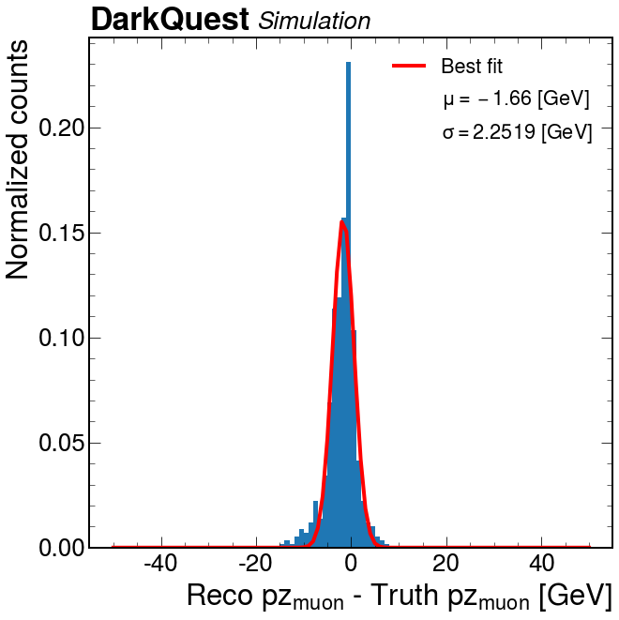
Medium A’ – peak
Pos pz
Neg pz

Slide 24
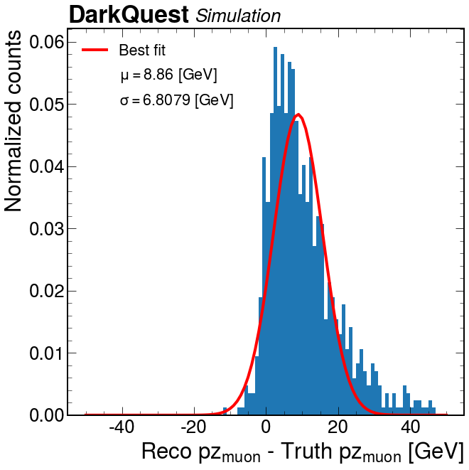
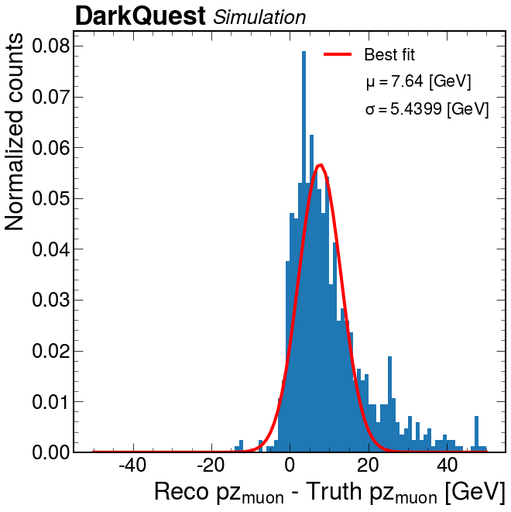
Medium A’ – tail
Pos pz
Neg pz

Slide 25
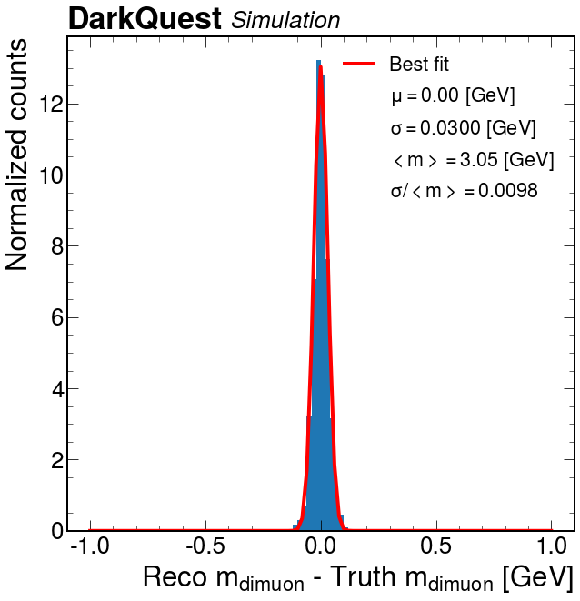
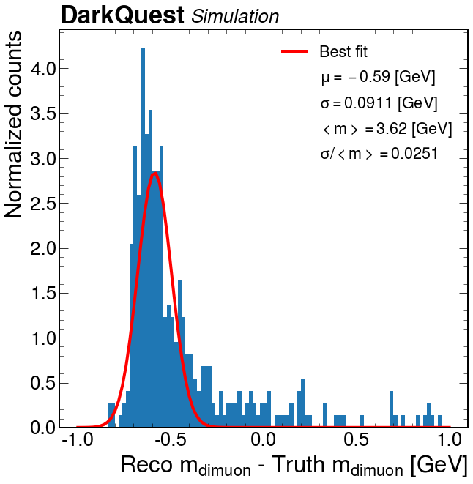
Heavy A’
DC off
DC on

Slide 26
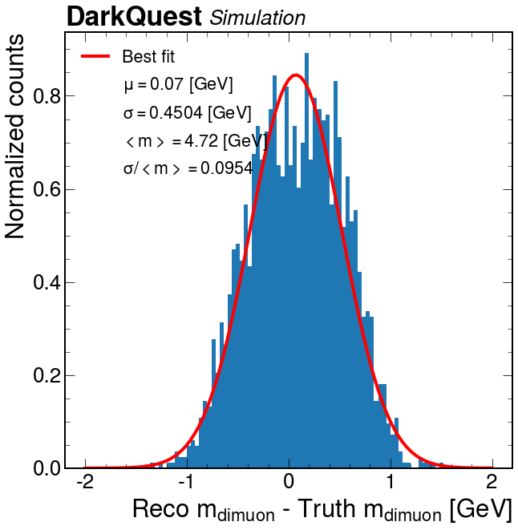
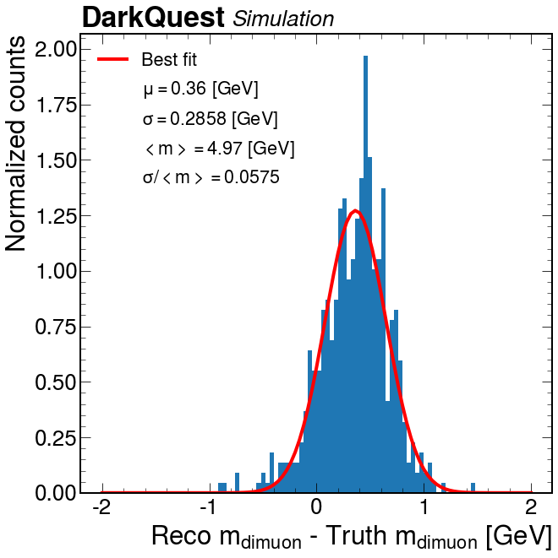
Drell-Yan
DC off
DC on

Slide 27
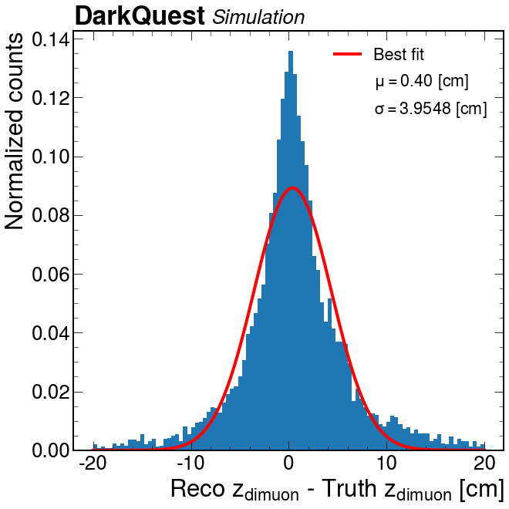
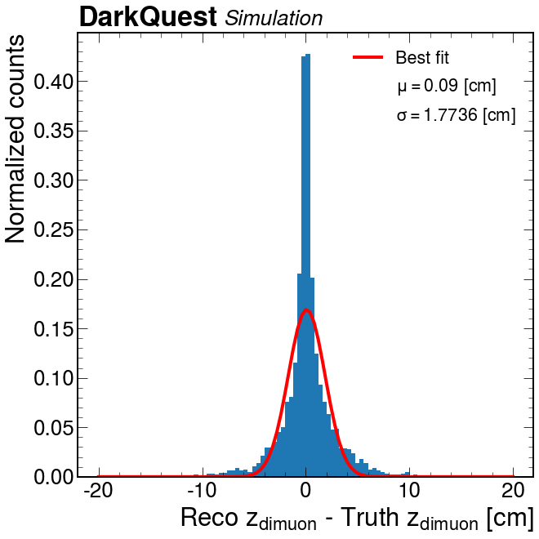
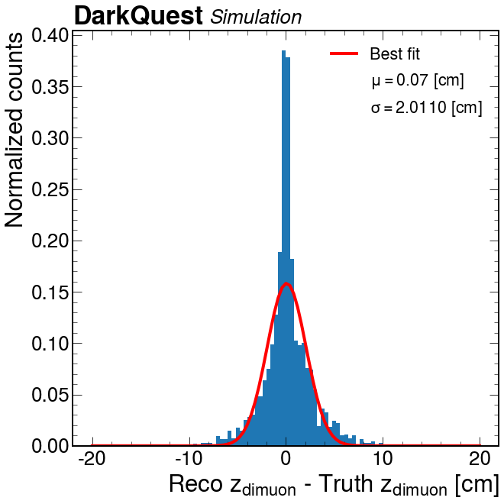
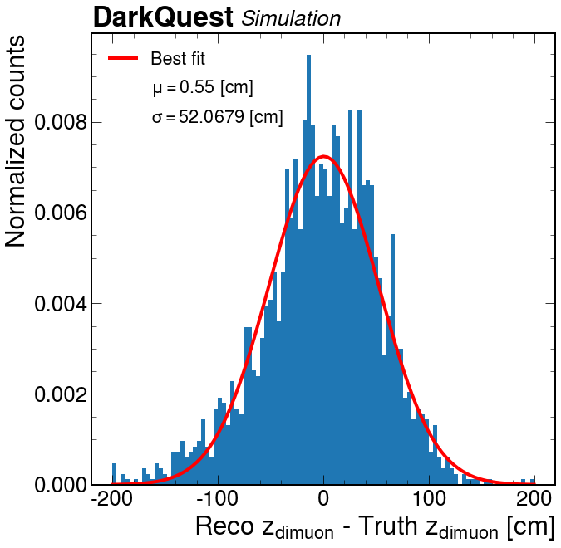
Z residual (DC emulation off)
Light mass
Medium mass
Heavy mass
DY

Slide 28
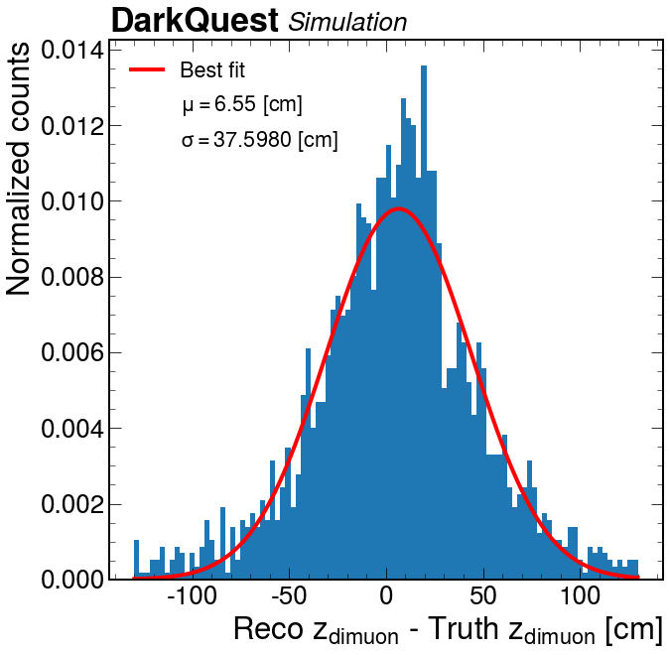
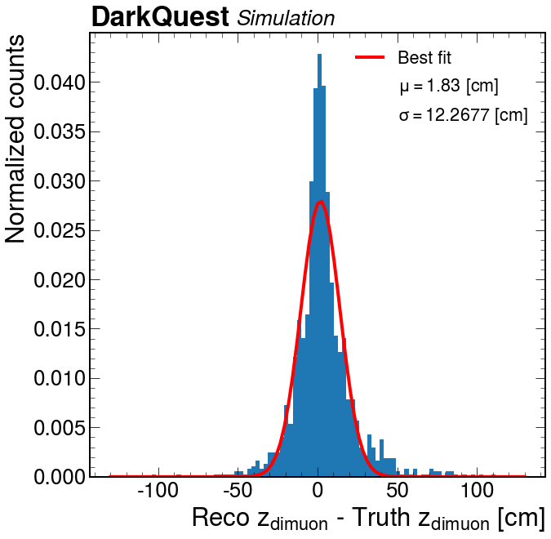
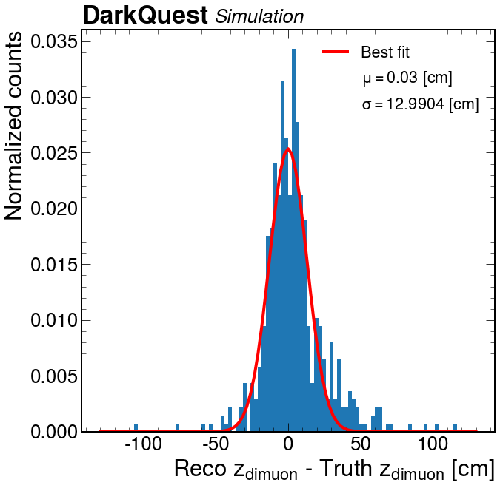
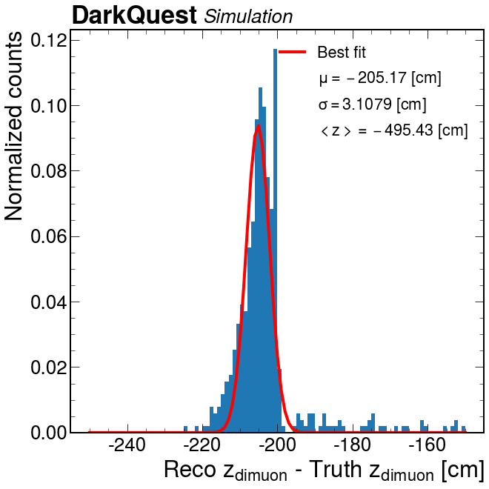
Z residual (DC emulation on)
Light mass
Medium mass
Heavy mass
DY

Slide 29
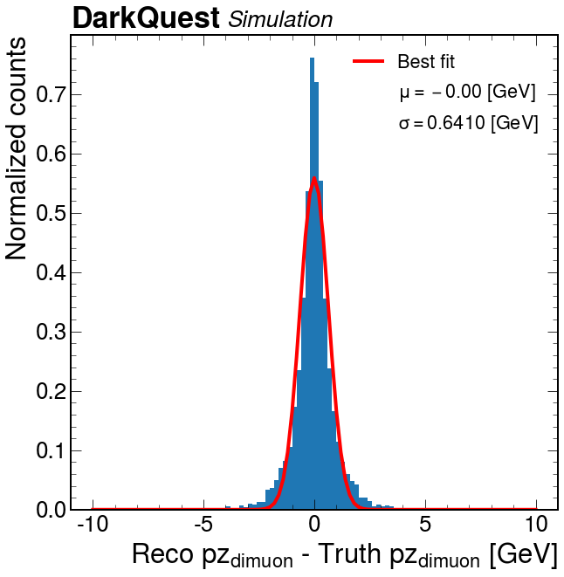
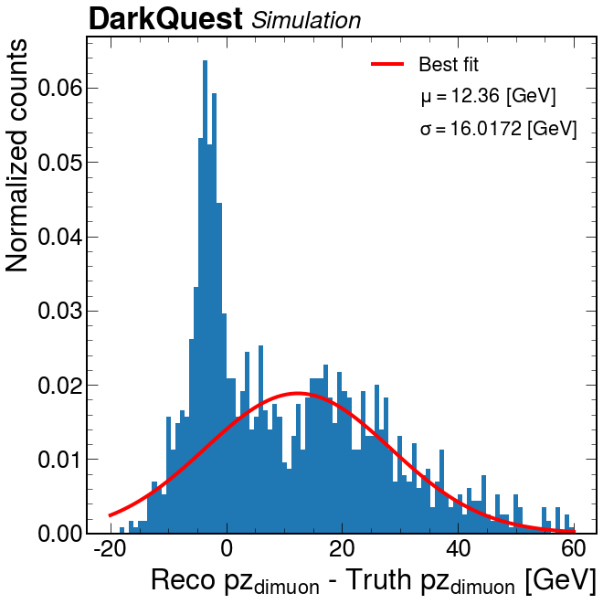
Pz res (medium mass)
DC OFF
DC ON

Slide 30
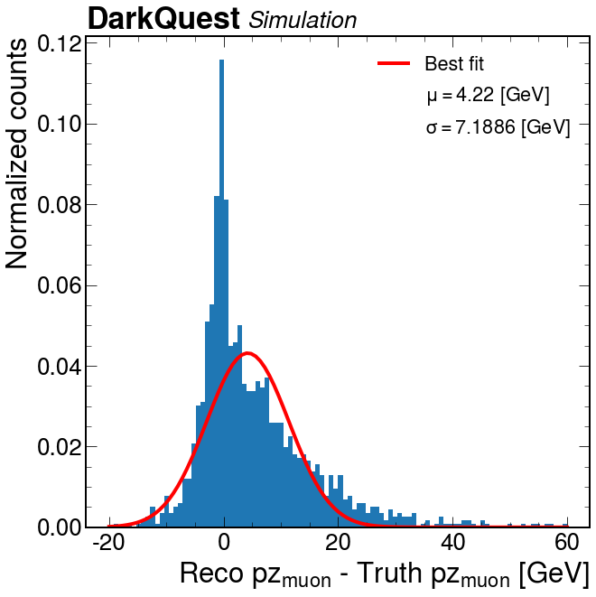
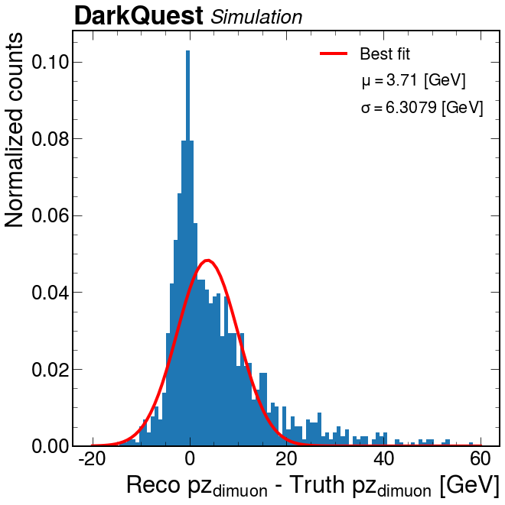
Pz res (medium mass) – individual muon – DC on
p_muon
n_muon

Slide 31
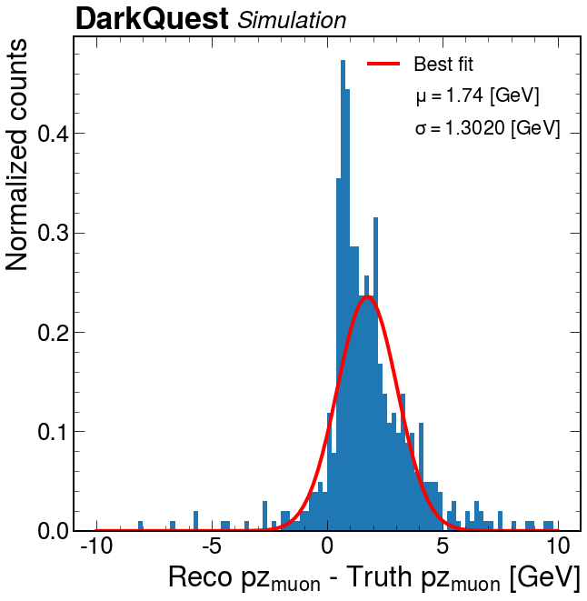
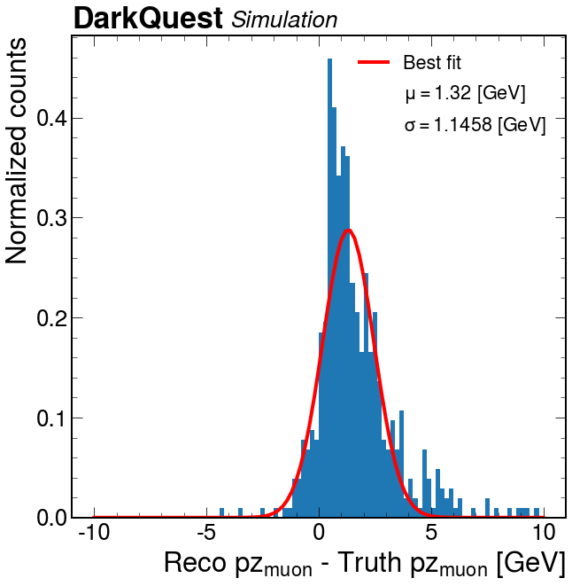
Pz res (light mass) – individual muon – DC on
p_muon
n_muon

Slide 32
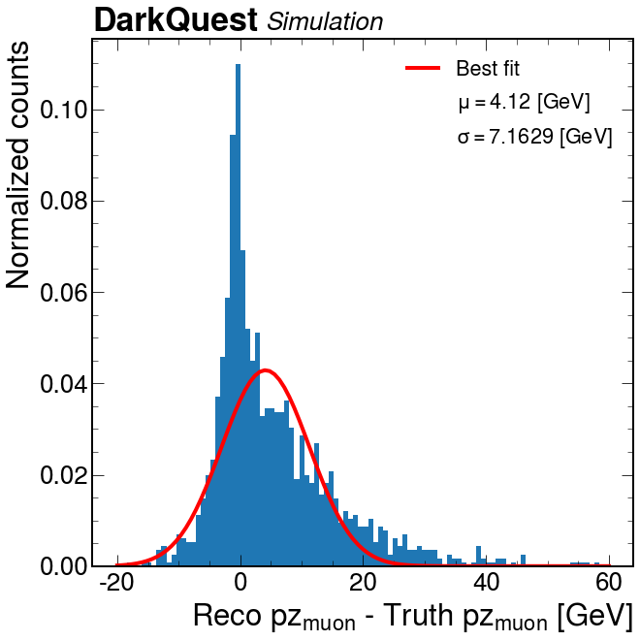
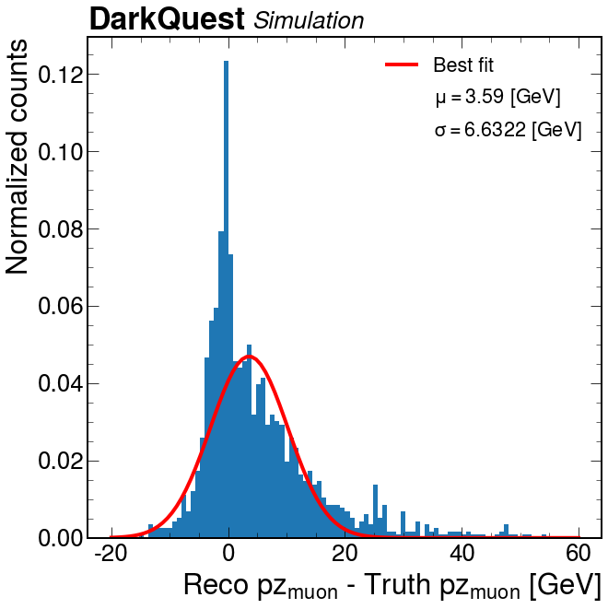
Pz res (medium mass) – prefit pz – DC on
p_muon
n_muon

Slide 33

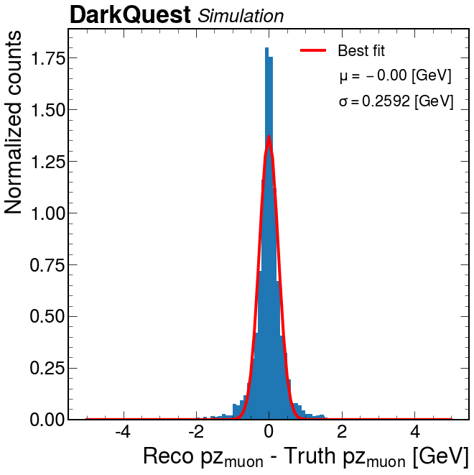
Pz res (medium mass) – prefit pz – DC off
p_muon
n_muon

Slide 34
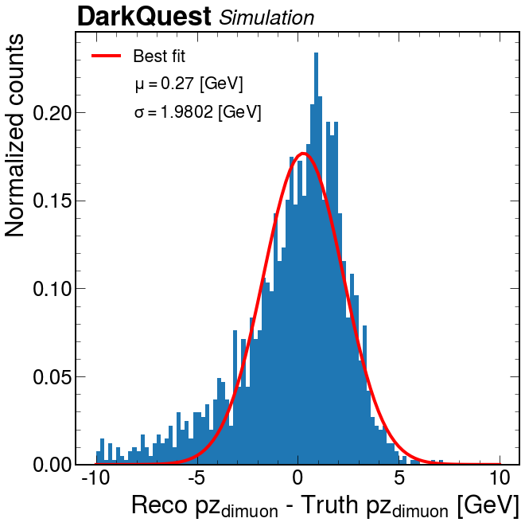
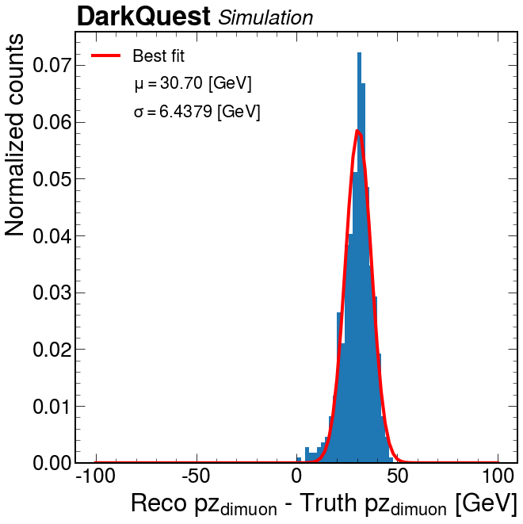
Pz res (drell yan)
DC OFF
DC ON

Slide 35
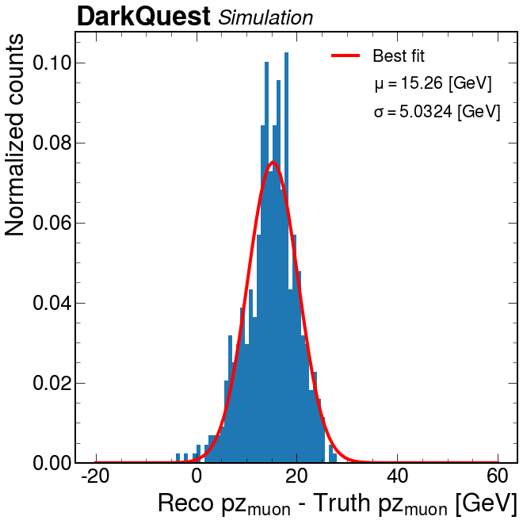
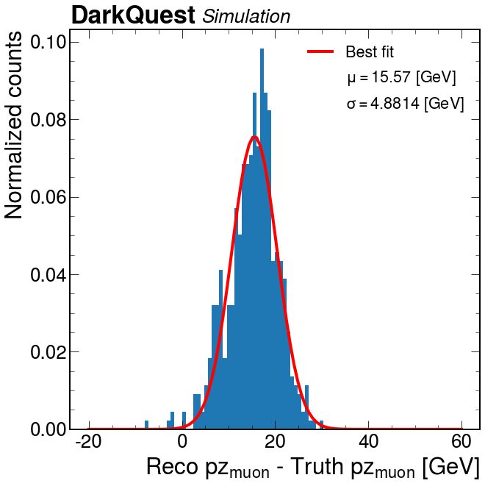
Pz res (drell yan) – individual muon
p_muon
n_muon

Slide 36
Particle ID (ver 1) study

Slide 37

Electron ID efficiency (10k events from electron gun)
Efficiency = correctly identified as e- tracks/number of reconstructed tracks.

Slide 38

“Not electron ID” efficiency (with muon gun)
Efficiency = not e-/number of reconstructed tracks.

Slide 39
Mass resolution as a function of decay position

Slide 40


Without DC emulation
Mass = 0.85GeV
All couplings
Finer bins (10 cm intervals)
Notes:
DPmuons_resolution_2_FMAG_noDC

Slide 41

Without DC emulation (zoomed in 400-530cm)
Mass = 0.85GeV
All couplings
Notes:
DPmuons_resolution_2_FMAG_noDC

Slide 42








Distribution
Mass = 0.85GeV
All couplings
Intervals of 50cm starting from 200
Notes:
DPmuons_resolution_2_FMAG

Slide 43










Reco mass - truth mass for different masses

Slide 44








Reco mass - truth mass for different masses - 2

Slide 45








Reco mass - truth mass for different masses - 3

Slide 46
With DC emulation
Mass = 0.85GeV
All couplings
Make the plots with the most dominant peak and make it clear that there is efficiency loss
Notes:
DPmuons_resolution_2_FMAG

Slide 47








Distribution
Mass = 0.85GeV
All couplings
Intervals of 50cm starting from 200
Notes:
DPmuons_resolution_2_FMAG

Slide 48








Reco mass - truth mass for different couplings

Slide 49








Reco mass - truth mass for different couplings - 2

Slide 50







Reco mass - truth mass for different masses

Slide 51








Reco mass - truth mass for different masses - 2

Slide 52








Reco mass - truth mass for different masses - 3

Slide 53

2D residual reco mass vs reco z
Mass = 0.85GeV
All couplings

Slide 54
Mass resolution for dielections

Slide 55
Efficiency plots for a’->mumu and A’->dielectrons

Slide 56
A’ -> muons without DC Emulation

Slide 57
Overview
Sample path (submit): /mnt/T2_US_MIT/hadoop/mitgroups/DarkQuest/dhoang/Aprime_Muons_Scan_z200_600_18_04_2022/
A Prime to muons Z200-600 sample
Acceptance divided into 2 cases (different denominator):
Use all events
Events with truth z from 500 to 600 cm

Slide 58


Track & Trigger acceptance (all 200-600cm)
Track acceptance (events with 2 tracks)
Trigger acceptance: (FPGA OR Zjie’s Trigger)
Notes:
plot/20-04-2022DP_track_accept_muons.pdf
plot/20-04-2022DP_trigger_accept.pdf

Slide 59


Track & Trigger acceptance (all 200-600cm) but only consider reco’ed events in 500-600
Track acceptance (events with 2 tracks)
Trigger acceptance: (FPGA OR Zjie’s Trigger)
Notes:
plot/20-04-2022DP_track_accept_muons.pdf
plot/20-04-2022DP_trigger_accept.pdf

Slide 60


Track & Trigger acceptance (500-600cm)
Track acceptance (events with 2 tracks)
Trigger acceptance: (FPGA OR Zjie’s Trigger)
Notes:
plot/20-04-2022DP_track_accept_muons_z500_600.pdf

Slide 61
A’ -> muons with DC Emulation

Slide 62


Track & Trigger acceptance (all 200-600cm)
Track acceptance (events with 2 tracks)
Trigger acceptance: (FPGA OR Zjie’s Trigger)
Notes:
plot/20-04-2022DP_track_accept_muons.pdf
plot/20-04-2022DP_trigger_accept.pdf

Slide 63


Track & Trigger acceptance (all within 500-600cm)
Track acceptance (events with 2 tracks)
Trigger acceptance: (FPGA OR Zjie’s Trigger)
Notes:
plot/20-04-2022DP_track_accept_muons_z500_600.pdf

Slide 64
A’ -> ee without DC Emulation

Slide 65
Overview
Sample path (submit): /mnt/T2_US_MIT/hadoop/mitgroups/DarkQuest/dhoang/Aprime_Electrons_Scan_z200_600_20_04_2022/
Z200-600 Aprime to electron sample
Acceptance divided into 2 cases (different denominator):
Use all events
Events with truth z from 500 to 600 cm

Slide 66


Track & Trigger acceptance (all 200-600cm)
Track acceptance (events with 2 tracks)
Trigger acceptance: (ECAL Trigger (sum > 2GeV))
Notes:
Notebook: APElectrons_eff_1_ECAL_Trigger_noDC_z200_600
plot/26-04-2022DP_track_accept_electrons.pdf
plot/26-04-2022

Slide 67


Track & Trigger acceptance (all 500-600cm)
Track acceptance (events with 2 tracks)
Trigger acceptance: (ECAL Trigger (sum > 2GeV))
Notes:
Notebook: APElectrons_eff_1_ECAL_Trigger_noDC_z200_600

Slide 68
A’ -> ee with DC Emulation

Slide 69
Overview
Sample path (submit): /mnt/T2_US_MIT/hadoop/mitgroups/DarkQuest/dhoang/DCEM_Aprime_Electrons_Scan_z200_600_26_04_2022/
Z200-600 Aprime to electron sample with DC emulation
Acceptance divided into 2 cases (different denominator):
Use all events
Events with truth z from 500 to 600 cm

Slide 70

Track & Trigger acceptance (all 200-600cm)
Track acceptance (events with 2 tracks)
Trigger acceptance: (ECAL Trigger (sum > 2GeV))
Notes:
Notebook: APElectrons_eff_2_ECAL_Trigger_DC_z200_600
plot/26-04-2022DP_track_accept_electrons.pdf
plot/26-04-2022

Slide 71

Track & Trigger acceptance (all 500-600cm)
Track acceptance (events with 2 tracks)
Trigger acceptance: (ECAL Trigger (sum > 2GeV))
Notes:
Notebook: APElectrons_eff_2_ECAL_Trigger_DC_z200_600

Slide 72
Sample Generation (Eta z200-600)
Path:

Slide 73
A’ -> electrons sample
With ECAL TRigger

Slide 74


Acceptance with Ecal trigger (sum of energy in ecal hits > threshold)
Threshold > 2 GeV
Threshold > 1 GeV
Notes:
Notebook: APElectrons_eff_1_ECAL_Trigger
Plots:
DP_Ecaltrigger2GeV_accept_electrons.pdf
DP_Ecaltrigger1GeV_accept_electrons.pdf
Comments:
From Patrick: Yeah, the backgrounds are the major issue here with lowering too far. Though I'll admit, I don't think the background simulation is doing a great job of matching reality, so I don't really know what the real background will look like in the EMCal

Slide 75
Mass resolution of electrons

Slide 76

Di electron mass resolution
Truth mass: 0.025659 GeV
Notes:
Standard SQ mass resolution is around 20% so it’s ok for now.
Patrick is working on a version of vertexing that might improve the tail
Notebooks: DPElectrons_resolution_1

Slide 77

Scaling w.r.t mass
Notes:
Notebooks: DPElectrons_resolution_1
Hit sharing adjustment

Slide 78

Scaling w.r.t coupling
Notes:
Notebooks: DPElectrons_resolution_1

Slide 79
A’ -> electrons sample

Slide 80
Overview
Similar to samples before but turn off the shielding between Fmag and station 1:
SetupInsensitiveVolumes(g4Reco, do_shielding, do_fmag, do_kmag, do_absorber); // insensitive volumes
SetupInsensitiveVolumes(g4Reco, do_shielding, do_fmag, do_kmag, do_absorber, 0, 0.25, 5., false); // insensitive volumes
old
new

Slide 81


First check with 1000 events samples

Slide 82


Checks from Patrick

Slide 83

Track acceptance (fraction of events that have 2 tracks)

Slide 84

Trigger acceptance (FPGA trigger or Zije’s trigger)

Slide 85
A’ -> ee plots

Slide 86

Track acceptance

Slide 87

Trigger acceptance

Slide 88
Resolution plots

Slide 89
Summary info:
Plots made using samples at: /mnt/T2_US_MIT/hadoop/mitgroups/DarkQuest/dhoang/Aprime_Muons_Scan_06_03_2022/Brem_0.950000_z500_600_eps_-4.6.root
This is new tracking after patrick’s bug fix
Notebook: /work/submit/dhoang/DQ/dq_notebooks/DPmuons_resolution_1

Slide 90


DP mass resolution
Single gaussian
Sum of two gaussians

Slide 91


Resolution in beam dump/not in beam dump
Di-muon reco z > 520 cm
Dimuon reco z < 520 cm

Slide 92


Resolution versus mass
coupling : 10^(-7.6)
Di-muon reco z > 520 cm
Dimuon reco z < 520 cm

Slide 93

Resolution versus mass (2)
coupling : 10^(-7.6)
Colinear tracks for lower masses.

Slide 94


Resolution versus coupling
mass: 0.95 GeV
Di-muon reco z > 520 cm
Dimuon reco z < 520 cm

Slide 95

Resolution versus coupling (2)
mass: 0.95 GeV

Slide 96
(10/2/2022) Efficiency study with patrick’s new setup.

Slide 97
List of efficiency plots
Dark photon acceptance.
3 times:
Without drift chambers emulation. (So far been running on this) ✅
Run with drift chamber emulation (eff shouldn’t decrease that much) ✅
Running with data overlay (also with emulation). (A bit more complicated, new install script.)
Muon gun acceptance with different setup
Do three samples with the data overlay.

Slide 98
Incorporating Zije’s DP trigger (w/ DC emulations)

Slide 99


Zije’s trigger (slide)
New DP hodoscope Trigger
Adding two dark photon hodoscopes in order to improve the trigger efficiency.
Trigger fires if hits are in the same quadrant for DP1, DP2, and H4Y detector.
Z-vertex reconstruction can be made based on the hit positions on DP1 & DP2.
80bars/quad (~1cm seg)
50 bars/quad (~2cm seg)
Y
ST-2
ST-1
TL
TR
X
BL
BR
KMAG
ST-3

Slide 100
Acceptance matrix
Fail all
Pass track but not trigger
Pass trigger but not track
Pass all
Definition:
Track: have 2 tracks reconstructed.
Trigger: Zije’s DP trigger
Sample on submit: /mnt/T2_US_MIT/hadoop/mitgroups/DarkQuest/dhoang/Aprime_Muons_Scan_26_02_2022/

Slide 101

Fail all

Slide 102

1- Fail all

Slide 103

2. Pass track but not trigger

Slide 104

3. Pass trigger but not track
Notes:
Include the weights

Slide 105

4. Pass both

Slide 106

Dark Photon track acceptance plot
Acceptance = fraction of events with 2 tracks.

Slide 107

Pass FPGA trigger OR Zije’s trigger

Slide 108
Dark photon acceptance but taken into account event weights

Slide 109

Dark photon acceptance plot (with Patrick’s setup)
Acceptance = fraction of events with 2 tracks.
Hue normalized from 0 to 1.

Slide 110
Acceptance matrix
Fail all
Pass track but not trigger
Pass trigger but not track
Pass all
Definition:
Track: have 2 tracks reconstructed.
Trigger: fpga_trigger[0] == 1
Main physics trigger.
Triggering on hits.

Slide 111

Fail all

Slide 112

1- Fail all

Slide 113

2. Pass track but not trigger

Slide 114

3. Pass trigger but not track
Notes:
Include the weights

Slide 115


4. Pass both
Change scale from (0,1) to (0,0.05)

Slide 116
Dark Photon acceptance with patrick’s new tracking setup

Slide 117

Dark photon acceptance plot (with Patrick’s setup)
Acceptance = fraction of events with 2 tracks.
Hue normalized from 0 to 1.

Slide 118
Acceptance matrix
Fail all
Pass track but not trigger
Pass trigger but not track
Pass all
Definition:
Track: have 2 tracks reconstructed.
Trigger: fpga_trigger[0] == 1
Main physics trigger.
Triggering on hits.

Slide 119

Fail all

Slide 120

1- Fail all

Slide 121

2. Pass track but not trigger

Slide 122

3. Pass trigger but not track
Notes:
Include the weights

Slide 123

4. Pass both

Slide 124
Efficiency study for muons in different scenario

Slide 125
Overview of study
Goal: to probe the efficiency of muons for different tracking setups.
Investigated 3 main tracking setups:
Default setup (master branch as of 8/31/2021).
Default setup and extrapolation off (at station 1).
Use e- flag with extrapolation off (at station 1).
For each setup, generate 3 different samples of varying gun position and momentum.

Slide 126
Overview of samples
Sample 1
Sample 2
Sample 3
Vtx: (0,0,520) cm
Pz: uniform, 0-100 GeV.
Px, py: uniform, -5 to 5 GeV.
Vtx_z: 520 cm
Vtx_x and vtx_y: -100 to 100cm
Pz: 0-100 GeV
Px,py: -0.01 to 0.01 GeV.
Vtx_x, vtx_y: 0cm
Vtx_z: 450-750cm
Pz: 0-100 GeV
Px, py: -1 to 1 GeV
Px, py efficiency
Vertex x,y pos efficiency
Z gun position w. efficiency.
Generated 100k events each.
Notes:
Sample 1: /data/t3home000/dhoang/DQ/job_submission/Muon_gun_scan/Muon_gun_pxpy
Sample 2: /data/t3home000/dhoang/DQ/job_submission/Muon_gun_scan/Muon_gun_x_y
Sample 3: /data/t3home000/dhoang/DQ/job_submission/Muon_gun_scan/Muon_gun_z

Slide 127
Definition of efficiency (for single muon gun)
Number of reconstructed tracks (either 0 or 1) / Total number of events.

Slide 128
Default setup

Slide 129



Default setup — sample 1
Notes:
Notebook path: /data/t3home000/dhoang/DQ/e1039-core/DarkQuest/e1039-analysis/dimuon_python/MuonEff_default_sample1.ipynb
Sample path: /data/t3home000/dhoang/DQ/outfiles/Muon_gun_pxy_01_09_2021

Slide 130


Default setup — sample 1 (2D efficiency)
Notes:
Notebook path: /data/t3home000/dhoang/DQ/e1039-core/DarkQuest/e1039-analysis/dimuon_python/MuonEff_default_sample1.ipynb
Sample path: /data/t3home000/dhoang/DQ/outfiles/Muon_gun_pxy_01_09_2021

Slide 131


Default setup — sample 2
Notes:
Notebook path: /data/t3home000/dhoang/DQ/e1039-core/DarkQuest/e1039-analysis/dimuon_python/MuonEff_default_sample1.ipynb
Sample path: /data/t3home000/dhoang/DQ/outfiles/Muon_gun_x_y_02_09_2021

Slide 132

Default setup — sample 3

Slide 133
Default setup (extrapolation off)

Slide 134



Default (extrapolation off) - sample 1
Notes:
Sample path: /data/t3home000/dhoang/DQ/job_submission/Muon_gun_scan/Muon_gun_pxpy/logs_Muon_gun_pxy_extraoff_03_09_2021

Slide 135


Default (extrapolation off) - sample 1 (2D)
Notes:
Sample path: /data/t3home000/dhoang/DQ/job_submission/Muon_gun_scan/Muon_gun_pxpy/logs_Muon_gun_pxy_extraoff_03_09_2021
Weird cut off.

Slide 136



Default (extrapolation off) - sample 1 (2D)
Check for the weird feature
Notes:
Sample path: /data/t3home000/dhoang/DQ/job_submission/Muon_gun_scan/Muon_gun_pxpy/logs_Muon_gun_pxy_extraoff_03_09_2021
Weird cut off.

Slide 137


Default (extrapolation off) - sample 2

Slide 138

Default (extrapolation off) - sample 3

Slide 139
EFlag on + extrapolation off

Slide 140



Sample 1 (1D efficiency)

Slide 141


Sample 1 (2D efficiency)

Slide 142


Sample 2

Slide 143

Sample 3

Slide 144
EFlag off + extrapolation off

Slide 145



Sample 1 (1D efficiency)

Slide 146


Sample 1 (2D efficiency)

Slide 147
EFlag off + extrapolation off (OLD TRACKING)

Slide 148



Sample 1 (1D efficiency)

Slide 149
ARCHIVE (CONFUSION ABOUT BRANCH)

Slide 150



EFlag + extrapolation off (sample 1)
Notes:
Notebook path:

Slide 151


EFlag + extrapolation off (sample 1) - 2D efficiency
Notes:
Notebook path:

Slide 152


EFlag + extrapolation off (sample 2)

Slide 153

EFlag + extrapolation off (sample 3)

Slide 154
ARCHIVE ENDS

Slide 155
(7/29/2021) z position efficiency scan after bug

Slide 156

Px = py = -0.3 GeV; pz = 80 GeV

Slide 157


Distributions of truth hits in station 1

Slide 158


Distributions of truth hits in station 2

Slide 159


Distributions of truth hits in station 3
Notes:
Maybe 0.1.
Y distribution in station 3 doesn’t make sense

Slide 160
(7/25/2021) px and py muon gun scan

Slide 161

Px efficiency scan
Px = -5 -> 3 GeV
Py = - 0.3 GeV
Pz = 80 GeV.
Z = 540 cm.

Slide 162

Py efficiency scan
Px = - 0.3 GeV
Py = -5 -> 3 GeV
Pz = 80 GeV.
Z = 540 cm.

Slide 163
(7/11/2021) Fixed Kinematics for muon gun

Slide 164

Px = py = -0.3 GeV; pz = 80 GeV
Notes:
Use DP sample.
Scan px and py and make the same efficiency plot (after understanding the scaling in z)
Run the track fits
Find the vertex.
Refit with this vertex constraints.
Vertex can be anywhere.
Should be able to do vertexing starting from 2m
Reproduce spinquest vertex plot.

Slide 165
Additional check - 1
Additional samples at 540. And 535. [cm] just to verify this:
At 540 cm: 980/3000 reconstructed.
At 535 cm: 1943/3000 reconstructed.

Slide 166

Additional check - 2
Scan 100 points. Investigate the efficiency in details.

Slide 167

Config overview
Px = 0, py =0, pz =80 GeV.
Scan from 0->6m
2 things to check:
After 5m exactly 0
Vary px and py abit.
Exactly 0
Notes:
At some point it doesn’t get enough hits.
Make trigger pass plot.
Chat with Zije to ask if he would like to check it.
Check multiplicity.

Slide 168

Px = py = 0.3 GeV; pz = 80 GeV
Exactly 0
Notes:
Use DP sample.
Scan px and py and make the same efficiency plot (after understanding the scaling in z)

Slide 169
(7/12/2021) Use new HEPMC files

Slide 170

Truth pz distribution for different couplings (fixed sampling)
Notes:
How is the cross section taken into account?
Gamma needs to be high for purple and low for green.

Slide 171
(7/11/2021) See how the acceptance changes after cristina’s fixed sampling.

Slide 172
Acceptance matrix
Fail all
Pass track but not trigger
Pass trigger but not track
Pass all
Definition:
Track: have 2 tracks reconstructed.
Trigger: fpga_trigger[0] == 1
Main physics trigger.
Triggering on hits.

Slide 173

Fail all
Hue normalization:
Bluest: -7.5
Reddest: -3
If more than -3 also reddest.

Slide 174


1- Fail all
Hue normalization:
Bluest: -7.5
Reddest: -3
If more than -3 also reddest.
Non fixed-sampling

Slide 175


2. Pass track but not trigger
Hue normalization:
Bluest: -7.5
Reddest: -3
If more than -3 also reddest.
Non fixed-sampling

Slide 176


3. Pass trigger but not track
Hue normalization:
Bluest: -7.5
Reddest: -3
If more than -3 also reddest.
Non fixed-sampling

Slide 177


3. Pass both
Hue normalization:
Bluest: -7.5
Reddest: -3
If more than -3 also reddest.
Non fixed-sampling

Slide 178
(7/3/2021) Fun project -- displaced vertex reconstruction with ML

Slide 179
Overview (DY)
Generated training/testing data set based on 5805 DY events with 2 reconstructed tracks.
⅔ are used for training.
⅓ are used for testing.

Slide 180

Model
Input (reconstructed info from station 1) -- n by 6 by 2 (2 muons as channels)
Muon 1 | x | y | z | px | py | pz
Muon 2 | x | y | z | px | py | pz
Vertex x, y, z, m

Slide 181


Training

Slide 182




(DY) Spatial & mass resolution from default vertexing
Spatial
Mass

Slide 183




(DY) Spatial & mass resolution from ML
[GeV]
[GeV]
Spatial
Mass

Slide 184
Overview (Dark Photon)
Generated training/testing data set based on 21753 dark photon events with 2 reconstructed tracks.
⅔ (14754) are used for training.
20% of these are used for validation during training.
⅓ (7179) are used for testing.

Slide 185


Custom loss function
x,y,z are not fixed anymore. So need to account for different scales.
Credit: Yongbin

Slide 186



ML Resolution on testing set

Slide 187
Conclusion
Using ML model (with Dark Photon sample), we can have:
X res: 0.26 cm
Y res: 0.24 cm
Z res: 9.7 cm
In the DY sample (default versus ML):
X res: 0.16 cm (ML: 0.882 cm)
Y res: 0.6 cm (ML: 0.834 cm)
Z res: 49.7 cm (ML: 0.1574 cm)
Mass res: (ML: 0.3431 GeV)
Notes:
Phil’s questions:
Are you normalizing the inputs?
No, not necessary since their scale doesn’t change during inference.
As for the predicted outputs, tried to normalize them so that x,y,z have the same scale but resulted in much worse performance (because you have to inverse-scale to get the reco values). Best to separate them at this point.
Is true x position fixed?
Nope …
Mix DY and Dark Photon. (Mix training maybe with proton)

Slide 188
(7/1/2021) displaced muon gun efficiency

Slide 189
Overview
Single muon-gun samples with 5k events each displaced from 0 -> 6m.
Px, py varies between 0-1 GeV
Pz from 0 to 100 GeV
Pseudo efficiency = # of events with at least 1 track reconstructed/#of generated events.
There are actually two things going on: geometry acceptance and the reconstruction efficiency.

Slide 190

Efficiency as a function of single muon gun position
Notes:
Px and py can be in any directions.
Generated particles might go outside.
Reconstruction efficiency.
Fix energy of the muon.
Start px,py=0, and pz fixed.
Do a constant pz (80 GeV).
Do uncertainty bars.

Slide 191


Training using MSE loss

Slide 192



ML model spatial resolution (on testing data)
Note: can push x,y resolution down by scaling the z coordinates

Slide 193
Ideas
Incorporate the fact that output is gaussian into the model.
Add magnetic field info to improve x resolution.
Add track infos from station 2 and 3.

Slide 194



Scaling the z coordinate (divide by 20)
Lose z resolution here. A solution might be to optimize x,y and z separately. So you get the best of both worlds

Slide 195

Optimize z by itself

Slide 196
(6/27/2021) Dark Photon mass resolution & acceptance

Slide 197

A’ to muons mass resolutions
5k events.
98 events have reconstructed 2 tracks.
Truth A’ mass: 2.75 GeV
Coupling: 10^(-6.4)
Displaced between 5-6m
Notes:
Some of the config files are empty.
Mass res would not depends that much.
Acceptance is more interesting.
There could be some truth info mistakenly goes into the reco.
Coordinate with David a bit.
Zije will be working on similar things with thesis.
Acceptance might be quite low now.
Might be able to increase.
Add another layer into the track reconstruction.
DPs are configured differently than each other.
Give info in x position.

Slide 198
Acceptance matrix
Fail all
Pass track but not trigger
Pass trigger but not track
Pass all
Definition:
Track: have 2 tracks reconstructed.
Trigger: fpga_trigger[0] == 1
Main physics trigger.
Triggering on hits.

Slide 199

Fail all
Hue normalization:
Bluest: -7.5
Reddest: -3
If more than -3 also reddest.

Slide 200
1- Fail all
Hue normalization:
Bluest: -7.5
Reddest: -3
If more than -3 also reddest.

Slide 201
2. Pass track but not trigger
Hue normalization:
Bluest: -7.5
Reddest: -3
If more than -3 also reddest.

Slide 202
3. Pass trigger but not track
Hue normalization:
Bluest: -7.5
Reddest: -3
If more than -3 also reddest.

Slide 203
3. Pass both
Hue normalization:
Bluest: -7.5
Reddest: -3
If more than -3 also reddest.

Slide 204

Acceptance as a function of displaced position
I just picked a specific mass.
1.25GeV.
54544 events
Notes:
Check with Cristina.
Add acceptance weights.
Reco efficiency
Do muon gun and displace it for the whole range.

Slide 205

A’ to muons acceptance
Default number of events for each config: 5000.
However, some config files might either be empty or don’t have a lot of entries.
Also plotting the number of events here to check.

Slide 206

A’ to muons acceptance (log acceptance scale)
Default number of events for each config: 5000.
However, some config files might either be empty or don’t have a lot of entries.
Also plotting the number of events here to check.

Slide 207

A’ to muons acceptance (remove 0 acceptance points)
Default number of events for each config: 5000.
However, some config files might either be empty or don’t have a lot of entries.
Also plotting the number of events here to check.
Bluer is lower!

Slide 208
(6/23/2021) Various resolutions

Slide 209

Momentum resolution before FMag
DY sample at target with 100k events.
Resolution based on 5806 reconstructed events.
Dimuon momentum resolution.

Slide 210

Momentum resolution before FMag (Δsigma/p)
DY sample at target with 100k events.
Resolution based on 5806 reconstructed events.
Dimuon momentum resolution.

Slide 211

Dimuon momentum resolution before & after the FMag
Displaced A’ to muons sample with 10k events.
Dimuon reco momentum not available at vertex yet, just add the reco momentum at Station 1 together.
1886 events reconstructed.
Notes:
Plot the actual mass resolution

Slide 212

Single muon momentum resolution before and after the Fmag.
DY sample at target with 100k events.
Resolution based on 5806 reconstructed events.
Notes:
Digging into the vertex resolution.
Adding the y information.

Slide 213



J/psi sample (min pz = 30 GeV)
100k Jpsi sample.
2171 events are reconstructed.
Notes:
Need to apply cuts to the quality of the tracks. (apply cuts).
Tracking meeting.

Slide 214




(6/16/2021) Sailor and Seagull Study

Slide 215

What is seagull and sailor?
Each case may affect the resolution differently.

Slide 216

Overview
50k events (- 14 events that have 4 muons) (DY events in the target)
24885 events are Seagull.
25101 events are Sailor.
2858 events are reconstructed.
All of them are Seagull????
Very confused because dimuon decay in Spinquest is usually thought of this way (sailor).
(Update 7/11/2021) All of them are Sailor since the magnetic field is in negative y direction. (Study was assuming it’s in the positive y direction).
Notes:
Might be a feature of spinquest.
Bias in spinquest.
Can check geometrically for the sailor case.
Check Seagull events that didn’t get reconstructed.
Good to see if we’re losing both tracks.
Maybe sign error for the coordinate.
Dark photon might have different acceptance for sailor and seagull.
Less magnetic field.
FMag sweep most of the events (from target)

Slide 217
(6/15/2021) Higher DY statistics plots

Slide 218


50k events sample -- mass resolution
From 10k sample

Slide 219


50k events sample -- mass resolution scale
From 10k sample

Slide 220


50k events sample -- momentum resolution scale
From 10k sample
~1.5%

Slide 221
100k events sample -- mass resolution
From 10k sample

Slide 222

100k events sample -- mass resolution scale
From 10k sample

Slide 223

100k events sample -- momentum resolution scale
From 10k sample

Slide 224
(6/4/2021) Mass resolution

Slide 225

Drell-Yan mass resolution
Generated 10k Drell-Yan events (non-displaced vertex).
~20% of events are reconstructed.
Evaluating the resolution based on those reconstructed events.

Slide 226

(Drell-Yan) Truth dimuon mass distribution

Slide 227
Vertex z resolution

Slide 228

Dimuon truth momentum distribution

Slide 229



(Drell-Yan) Mass RMS vs p
p = sum of momentum of the two muons.

Slide 230



(Drell-Yan) RMS vs p -- Backup

Slide 231



DY--Track Momentum Resolution

Slide 232
(5/30/2021) Matching truth and reco

Slide 233
Overview
At each vertex, there are truth info of the muons available:
[info of particle 1, info of particle 2]
However, the reconstructed info (since it’s not perfect) is usually:
[info of a reconstructed muon] or [] or [reco muon # 1, reco muon # 2]
The question is, how do we compare the reco and truth info?
By doing momentum matching, taking the max pz momentum muon of reco and truth!!
The matching usually is quite well, see here.

Slide 234
Matching reconstructed muons
For events with 2 reconstructed muons
Match the corresponding pz:
Larger pz with larger pz
Smaller pz with smaller pz
For events with just 1 reconstructed muon:
Match to the truth muon with the closest pz.

Slide 235



Initial check (plot Δposition/momentum)
Define shift as: reconstructed muon position in station 1 - truth muon position at vertex.

Slide 236




Momentum resolution (first try on signal sample)

Slide 237

Momentum resolution (first try on signal sample)
Notes:
Topology might be different.
Check the average momentum in each bin.

Slide 238





Similarly, here are px resolution as a function of truth pz

Slide 239





Similarly, here are py resolution as a function of truth pz

Slide 240
Plans
Run reconstruction on J/psi samples and make mass plot, then compare with the SpinQuest’s.
Can the macro run on this sample?
After vertex can be reconstructed, make the mass plot for A’ sample.

Slide 241



Δx/y/z of truth vertex with reco hits and max truth momentum at vertex.
Change to pz
Notes:
Pz for all of them is the most correct way.
Use all the truh info.

Slide 242



Δx/y/z of truth vertex with reco hits and max reco momentum at st1.
Change to pz

Slide 243
(5/20/2021) Dimuon Vertex fitting

Slide 244



Truth momentum distribution at vertex

Slide 245



Comparing truth track momentum at the vertex and at station 1

Slide 246



Comparing truth track hit position at station 1 and at the vertex
We expect that the track is a straight line pointing between the vertex and the hit at station 1. (Assuming the A’ decays between the FMag and Station 1 (5-6m))

Slide 247

Comparing truth and reconstructed momentum at station 1.
Want to know momentum resolution on displaced tracks.
10k events: 5674 cannot be reconstructed. Efficiency ~30-40%.
Estimated by taking the ratio of the number of reconstructed tracks & the number of gen muons in each momentum bin.
Yongbin’s plot

Slide 248



Quick evaluation of momentum and position resolution (at station 1).
Taking the max momentum in the x, y, z directions of truth & reconstructed events and compare them for now. (No matching yet)
Yongbin’s plots

Slide 249



Position residual of the max momentum events (Station 1)
For some reason reco track hit z in station 1 is always 595 cm and truth z is always 617cm.

Slide 250



Change in truth position (st1 - vertex) and truth momentum
Notes:
Extend the range,

Slide 251



Is there any x,y dependence on z?

Slide 252
Matching truth info at vertex and reco at station 1:
To further evaluate the resolution of reconstructed tracks, need to match truth and reco objects since track efficiency is not 100%:
2 ideas:
Match based on leading Pz (like I did with the station 1 truth and reco values).
Pick the reco hit closest to a truth hit at station 1 and trace it back to truth vertex.

Slide 253
Vertex fitting
Want this point at the seed.
Yongbin has been trying to do some linear interpolation but it doesn’t work so far.
Spinquest assuming the vertex coming from the target
SpinQuest take average of these two points and feed it as the seed to Kalman filter.
Fmag
Station 1
Notes:
Physics reason: muon lose 7GeV at the Fmag
Fmag is complicated
Can take muon and assume a trajectory that spread at the front of the Fmag.
Momentum doesn’t change.

Slide 254
(4/12/2021) Reproducing plots from Yongbin

Slide 255





Reproducing Yongbin’s codes
Notes:
Based on 10k signal events

Slide 256
Current plan
Muon track reconstruction for A’ to muons or muon gun, make performance plot. ✅
Look at displaced vertex reconstruction and see if displaced vertex can be reconstructed. 👈
Add another track station layer and see if there are any improvement in performance.
Wire chamber somewhere, thinking about adding it into SpinQuest.
Add it and see how much better the resolutions are.
Thinking about how this helps SpinQuest.
More discussions to come.

Slide 257
(3/29/2021) SET UP NOTES

Slide 258
Plans (3/31/2021)
Set up computing accounts ✅
Look at single muon tracking example root files and install simulation framework. ✅
(Upgrade the Spin Quest simulation framework to generate more basic tracking info).
Youngbin is working on some basic displaced tracking in the simulation.
Might take his setup and complete (or optimize) it when summer starts.
Basic set up of analysis codes. ✅
Overview: Will work more with Cristina (and Youngbin) to try to get a sense of what is there and what we need to implement (before the summer starts).

Slide 259
#random
Introduction to DarkQuest (main purpose is to provide a basic introduction for new students, and gather all the getting-started resources in one page):
https://medium.com/darkquest/the-darkquest-experiment-1b8e46de1e40

Slide 260
Code workflow
Signal file configurations
Simulation codes
Ntuples
Simulation of Dark Brems.

Slide 261
Kalman filter

Slide 262


Slide 263
Different links
Thesis used to explore the reconstruction of SpinQuest:
https://seaquest-docdb.fnal.gov/cgi-bin/RetrieveFile?docid=7759&filename=CA_Thesis_Seaquest_Final.pdf&version=4
Instruction to install:
https://github.com/cmantill/DarkQuest/blob/master/e1039-analysis/SimHits/README.MD
Cristina’s DarkQuest repo:
https://github.com/cmantill/DarkQuest
Tracking examples file path: /seaquest/users/cmantill/DarkQuest/e1039-analysis/SimHits/macro/*simana.root

Slide 264
Input text files notation
So these files are all simulation of a dark matter process, where a new dark photon (A') is produced. This particular production mechanism of the dark photon is called proton Bremsstrahlung (similar to the electron Bremsstrahlung of when an electron loses some of its energy and emits a photon), so we abbreviate it with "Brem". This is what "Brem" means in these files (edited)
The second number is the mass of the A' particle in GeV, so we are looking for some "low mass" signals
The z500_600 means that the A' is produced somewhere within 5-6 m from where the proton hits the target
and finally eps_-6 represents the mixing coupling (the strength of the interaction of the dark matter photon w. the normal photon) = 10^(-6).

Slide 265


Slide 266


